Slide 1
Item | W0 | W1 | W2 | W3 | W4 | W5 | W6 | - | W7 | W8 | W9 | W10
[Deadline] Research Proposal | 6-11
RQ 1: Finding data sets
RQ 1: Generating a framework
RQ 2: Research mathematical foundation of NGs
RQ 2: Develop Python NG generation tool
RQ 2: Test and validate the NG generation tool
RQ 3: Literature review on Markov Chains
[Deadline] Draft Paper |  |  |  |  |  | 11-12
RQ 3: Develop Python visualization tool for NGs
RQ 3: Characterize NGs
MQ: Combine RQs
MQ: Conclude MQ
Proofread
[Deadline] Final Paper |  |  |  |  |  |  |  |  |  |  | 22-01
[Deadline] Presentation |  |  |  |  |  |  |  |  |  |  |  | 29-01

Slide 2
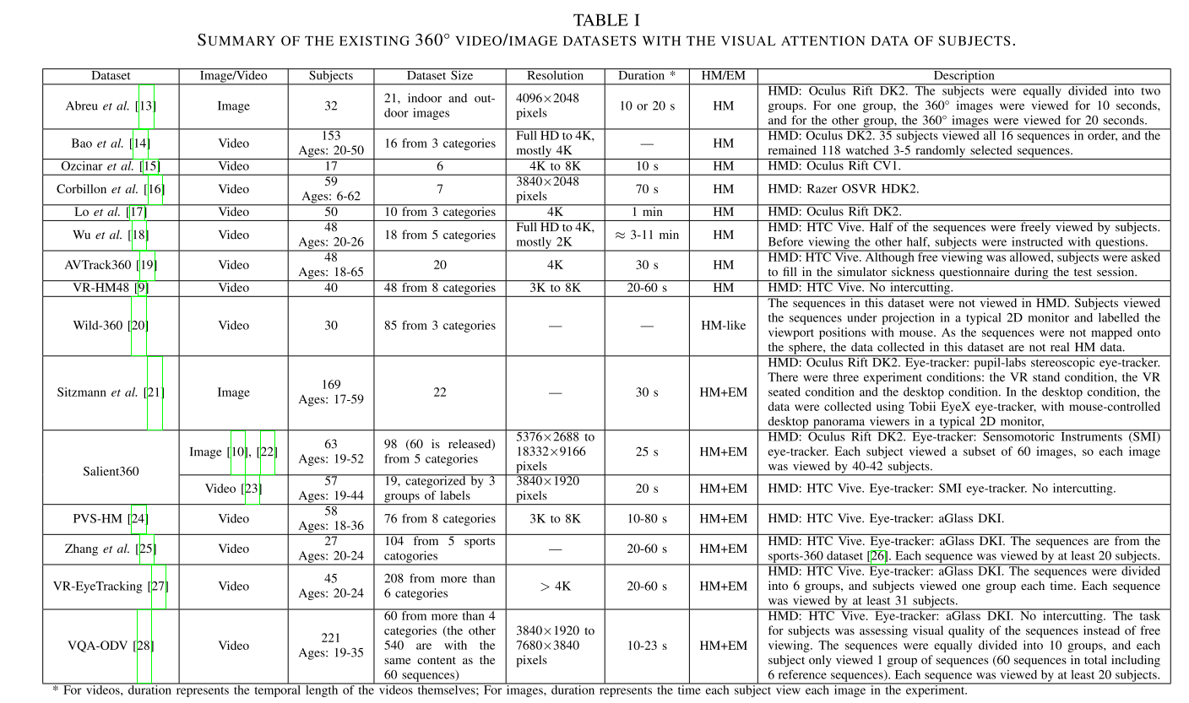

Slide 3



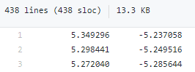
Dataset:
Paper:
40 participants
18 videos
5 categories
Unit-quaternion
X/Y/Z
https://dl-acm-org.ezproxy2.utwente.nl/do/10.1145/3192423/abs/
https://dl-acm-org.ezproxy2.utwente.nl/doi/10.1145/3083187.3083210
https://github.com/Archer-Tatsu/head-tracking
Data set:
Paper:
40 participants
48 videos
8 categories
Latitude/longitude
https://ieeexplore-ieee-org.ezproxy2.utwente.nl/abstract/document/8019351

Slide 4
Item | W0 | W1 | W2 | W3 | W4 | W5 | W6 | - | W7 | W8 | W9 | W10
[Deadline] Research Proposal | 6-11
RQ 1: Finding data sets
RQ 1: Generating a framework
RQ 2: Research mathematical foundation of NGs
RQ 2: Develop Python NG generation tool
RQ 2: Test and validate the NG generation tool
RQ 3: Literature review on Markov Chains
[Deadline] Draft Paper |  |  |  |  |  | 11-12
RQ 3: Develop Python visualization tool for NGs
RQ 3: Characterize NGs
MQ: Combine RQs
MQ: Conclude MQ
Proofread
[Deadline] Final Paper |  |  |  |  |  |  |  |  |  |  | 22-01
[Deadline] Presentation |  |  |  |  |  |  |  |  |  |  |  | 29-01

Slide 5
https://github.com/Archer-Tatsu/head-tracking
Data set:
Paper:
40 participants
48 videos
8 categories
Latitude/longitude
https://ieeexplore-ieee-org.ezproxy2.utwente.nl/abstract/document/8019351

Slide 6
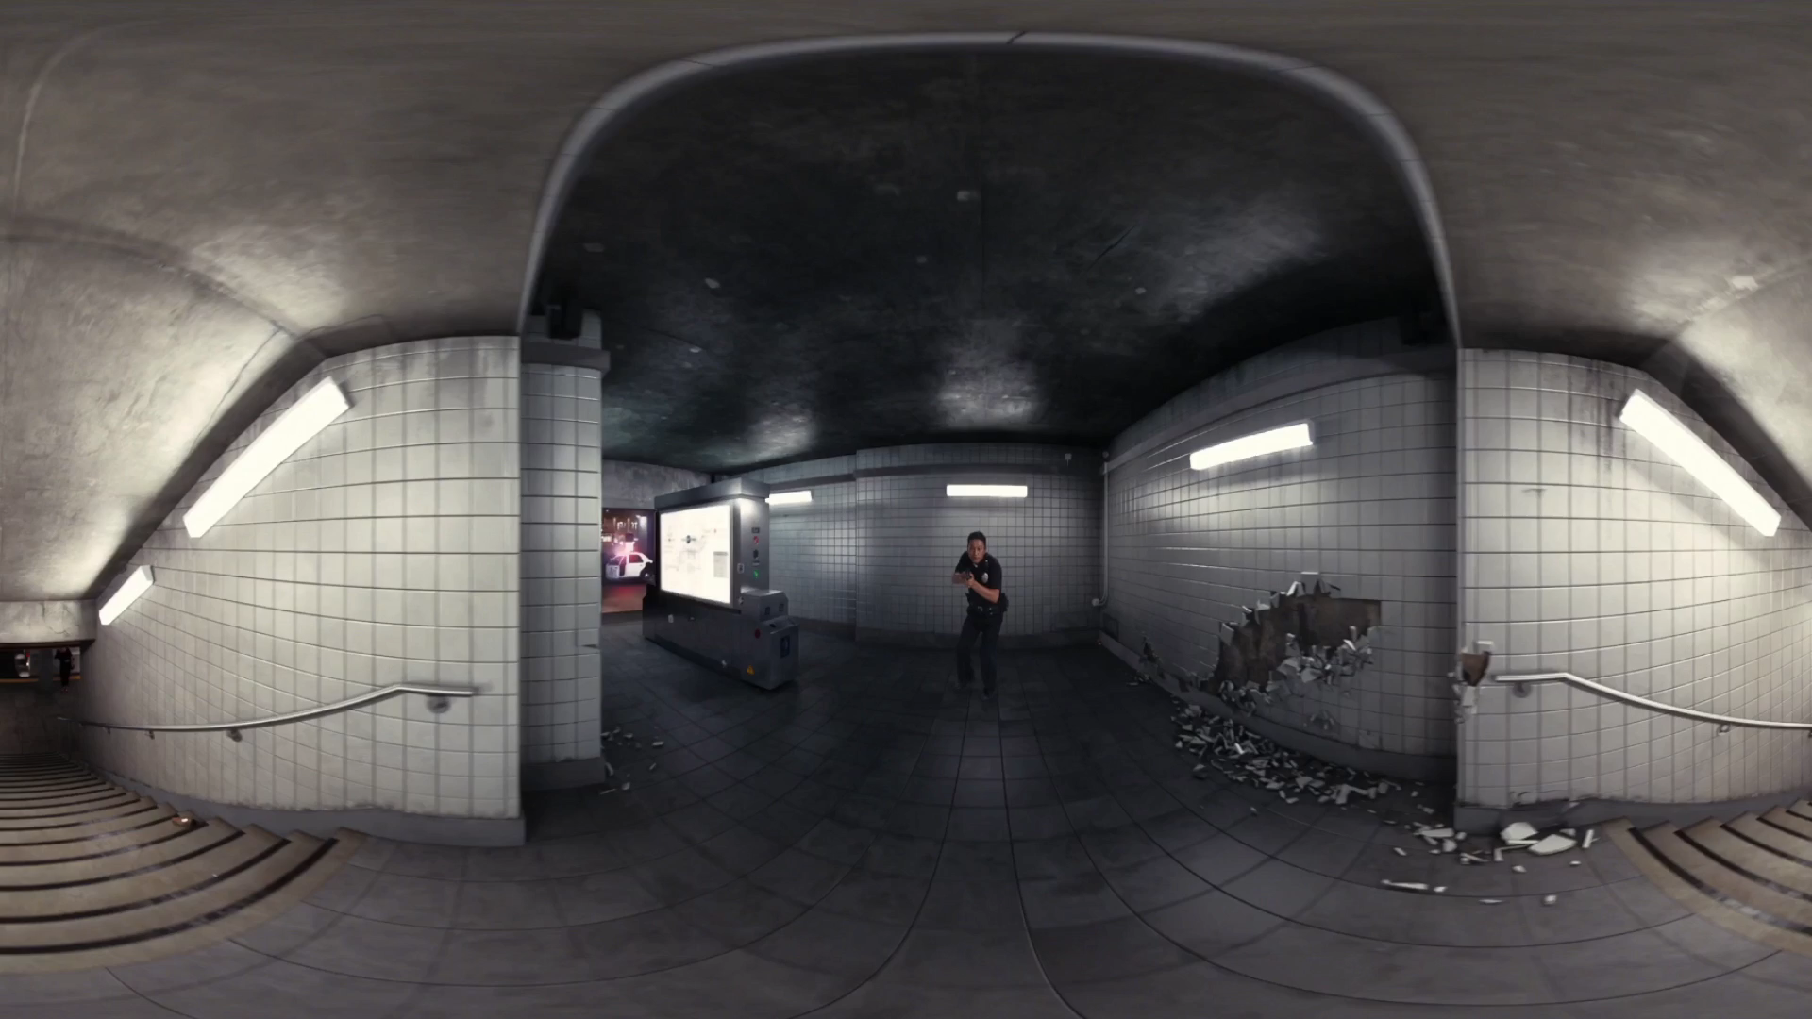

Slide 7
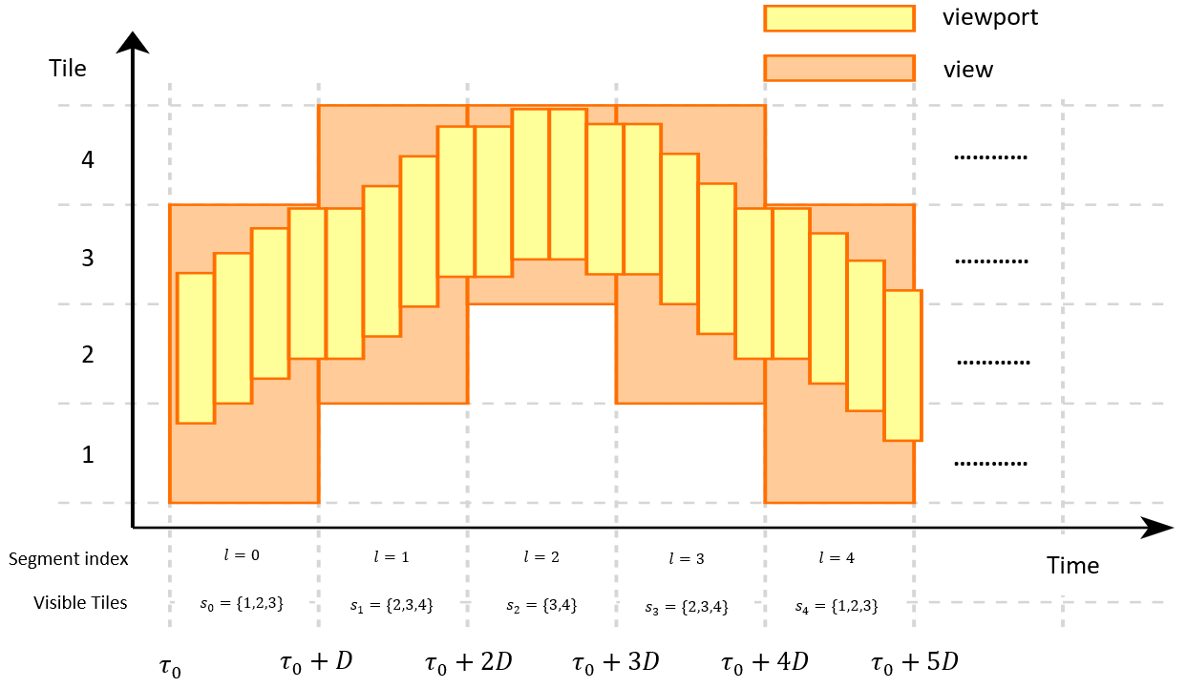
Tiling and segment length is up to us
Navigation graph is about view transitions
View: union of viewports within one segment
Nodes: {Set of Tiles, Segment index}
Edges: {Weight function (probability of from one node to the next)}

Slide 8
Item | W0 | W1 | W2 | W3 | W4 | W5 | W6 | - | W7 | W8 | W9 | W10
[Deadline] Research Proposal | 6-11
RQ 1: Finding data sets
RQ 1: Generating a framework
RQ 2: Research mathematical foundation of NGs
RQ 2: Develop Python NG generation tool
RQ 2: Test and validate the NG generation tool
RQ 3: Literature review on Markov Chains
[Deadline] Draft Paper |  |  |  |  |  | 11-12
RQ 3: Develop Python visualization tool for NGs
RQ 3: Characterize NGs
MQ: Combine RQs
MQ: Conclude MQ
Proofread
[Deadline] Final Paper |  |  |  |  |  |  |  |  |  |  | 22-01
[Deadline] Presentation |  |  |  |  |  |  |  |  |  |  |  | 29-01

Slide 9
Item | W0 | W1 | W2 | W3 | W4 | W5 | W6 | - | W7 | W8 | W9 | W10
[Deadline] Research Proposal | 6-11
RQ 1: Finding data sets
RQ 1: Generating a framework
RQ 2: Research mathematical foundation of NGs
RQ 2: Develop Python NG generation tool
RQ 2: Test and validate the NG generation tool
RQ 3: Literature review on Markov Chains
[Deadline] Draft Paper |  |  |  |  |  | 11-12
RQ 3: Develop Python visualization tool for NGs
RQ 3: Characterize NGs
MQ: Combine RQs
MQ: Conclude MQ
Proofread
[Deadline] Final Paper |  |  |  |  |  |  |  |  |  |  | 22-01
[Deadline] Presentation |  |  |  |  |  |  |  |  |  |  |  | 29-01

Slide 10
Item | W0 | W1 | W2 | W3 | W4 | W5 | W6 | - | W7 | W8 | W9 | W10
[Deadline] Research Proposal | 6-11
RQ 1: Finding data sets
RQ 1: Generating a framework
RQ 2: Research mathematical foundation of NGs
RQ 2: Develop Python NG generation tool
RQ 2: Test and validate the NG generation tool
RQ 3: Literature review on Markov Chains
[Deadline] Draft Paper |  |  |  |  |  | 11-12
RQ 3: Develop Python visualization tool for NGs
RQ 3: Characterize NGs
MQ: Combine RQs
MQ: Conclude MQ
Proofread
[Deadline] Final Paper |  |  |  |  |  |  |  |  |  |  | 22-01
[Deadline] Presentation |  |  |  |  |  |  |  |  |  |  |  | 29-01

Slide 11
Item | W0 | W1 | W2 | W3 | W4 | W5 | W6 | - | W7 | W8 | W9 | W10
[Deadline] Research Proposal | 6-11
RQ 1: Finding data sets
RQ 1: Generating a framework
RQ 2: Research mathematical foundation of NGs
RQ 2: Develop Python NG generation tool
RQ 2: Test and validate the NG generation tool
RQ 3: Literature review on Markov Chains
[Deadline] Draft Paper |  |  |  |  |  | 11-12
RQ 3: Develop Python visualization tool for NGs
RQ 3: Characterize NGs
MQ: Combine RQs
MQ: Conclude MQ
Proofread
[Deadline] Final Paper |  |  |  |  |  |  |  |  |  |  | 22-01
[Deadline] Presentation |  |  |  |  |  |  |  |  |  |  |  | 29-01

Slide 12
Item | W0 | W1 | W2 | W3 | W4 | W5 | W6 | - | W7 | W8 | W9 | W10
[Deadline] Research Proposal | 6-11
RQ 1: Finding data sets
RQ 1: Generating a framework
RQ 2: Research mathematical foundation of NGs
RQ 2: Develop Python NG generation tool
RQ 2: Test and validate the NG generation tool
RQ 3: Literature review on Markov Chains
[Deadline] Draft Paper |  |  |  |  |  | 11-12
RQ 3: Develop Python visualization tool for NGs
RQ 3: Characterize NGs
MQ: Combine RQs
MQ: Conclude MQ
Proofread
[Deadline] Final Paper |  |  |  |  |  |  |  |  |  |  | 22-01
[Deadline] Presentation |  |  |  |  |  |  |  |  |  |  |  | 29-01

Slide 13
Item | W0 | W1 | W2 | W3 | W4 | W5 | W6 | - | W7 | W8 | W9 | W10
[Deadline] Research Proposal | 6-11
RQ 1: Finding data sets
RQ 1: Generating a framework
RQ 2: Research mathematical foundation of NGs
RQ 2: Develop Python NG generation tool
RQ 2: Test and validate the NG generation tool
RQ 3: Literature review on Markov Chains
[Deadline] Draft Paper |  |  |  |  |  | 11-12
RQ 3: Develop Python visualization tool for NGs
RQ 3: Characterize NGs
MQ: Combine RQs
MQ: Conclude MQ
Proofread
[Deadline] Final Paper |  |  |  |  |  |  |  |  |  |  | 22-01
[Deadline] Presentation |  |  |  |  |  |  |  |  |  |  |  | 29-01

Slide 14
Item | W0 | W1 | W2 | W3 | W4 | W5 | W6 | - | W7 | W8 | W9 | W10
[Deadline] Research Proposal | 6-11
RQ 1: Finding data sets
RQ 1: Generating a framework
RQ 2: Research mathematical foundation of NGs
RQ 2: Develop Python NG generation tool
RQ 2: Test and validate the NG generation tool
RQ 3: Literature review on Markov Chains
[Deadline] Draft Paper |  |  |  |  |  | 11-12
RQ 3: Develop Python visualization tool for NGs
RQ 3: Characterize NGs
MQ: Combine RQs
MQ: Conclude MQ
Proofread
[Deadline] Final Paper |  |  |  |  |  |  |  |  |  |  | 22-01
[Deadline] Presentation |  |  |  |  |  |  |  |  |  |  |  | 29-01

Slide 15
Item | W0 | W1 | W2 | W3 | W4 | W5 | W6 | - | W7 | W8 | W9 | W10
[Deadline] Research Proposal | 6-11
RQ 1: Finding data sets
RQ 1: Generating a framework
RQ 2: Research mathematical foundation of NGs
RQ 2: Develop Python NG generation tool
RQ 2: Test and validate the NG generation tool
RQ 3: Literature review on Markov Chains
[Deadline] Draft Paper |  |  |  |  |  | 11-12
RQ 3: Develop Python visualization tool for NGs
RQ 3: Characterize NGs
MQ: Combine RQs
MQ: Conclude MQ
Proofread
[Deadline] Final Paper |  |  |  |  |  |  |  |  |  |  | 22-01
[Deadline] Presentation |  |  |  |  |  |  |  |  |  |  |  | 29-01

